Slide 1
Welcome to PyTym
Project on Timesheet Tracking, # die Ihnen die Arbeit erleichtern
Author : Priya Subramanian
Released on: 04 –June- 2021 Version: 1.0
alfaview
Course Name: Programing with Python
Professor: Dr.Eng. Christoph Feiler
10.05.2021 – 04.06.2021

Slide 2
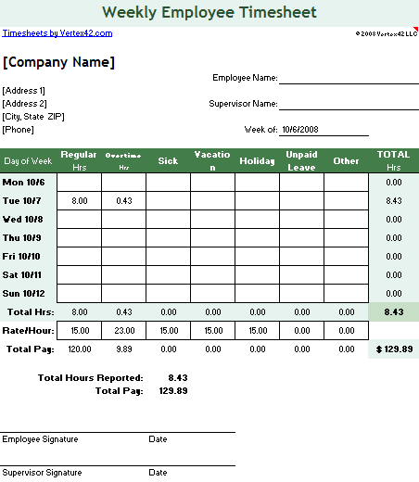
Login Proccess, help Kick-off and Access individual Account
Registration and Login requires everywhere, either you are filling any form or want to access any application. PyTym follows how to implement user registration and login in python.

Slide 3
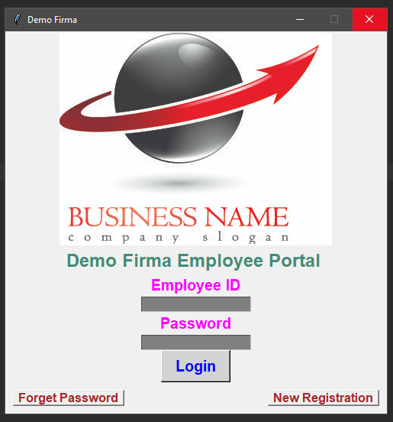
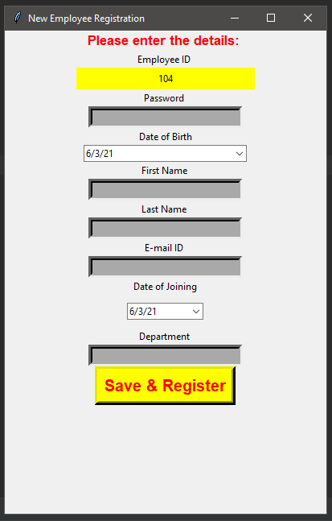
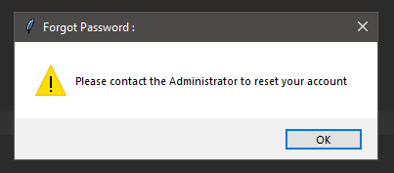
Program Login / Logout Window
Create Login Class with inbuilt below functions
1
Verify Login
2
New Registeration
3
Confirm Registeration
4
Logout

Slide 4
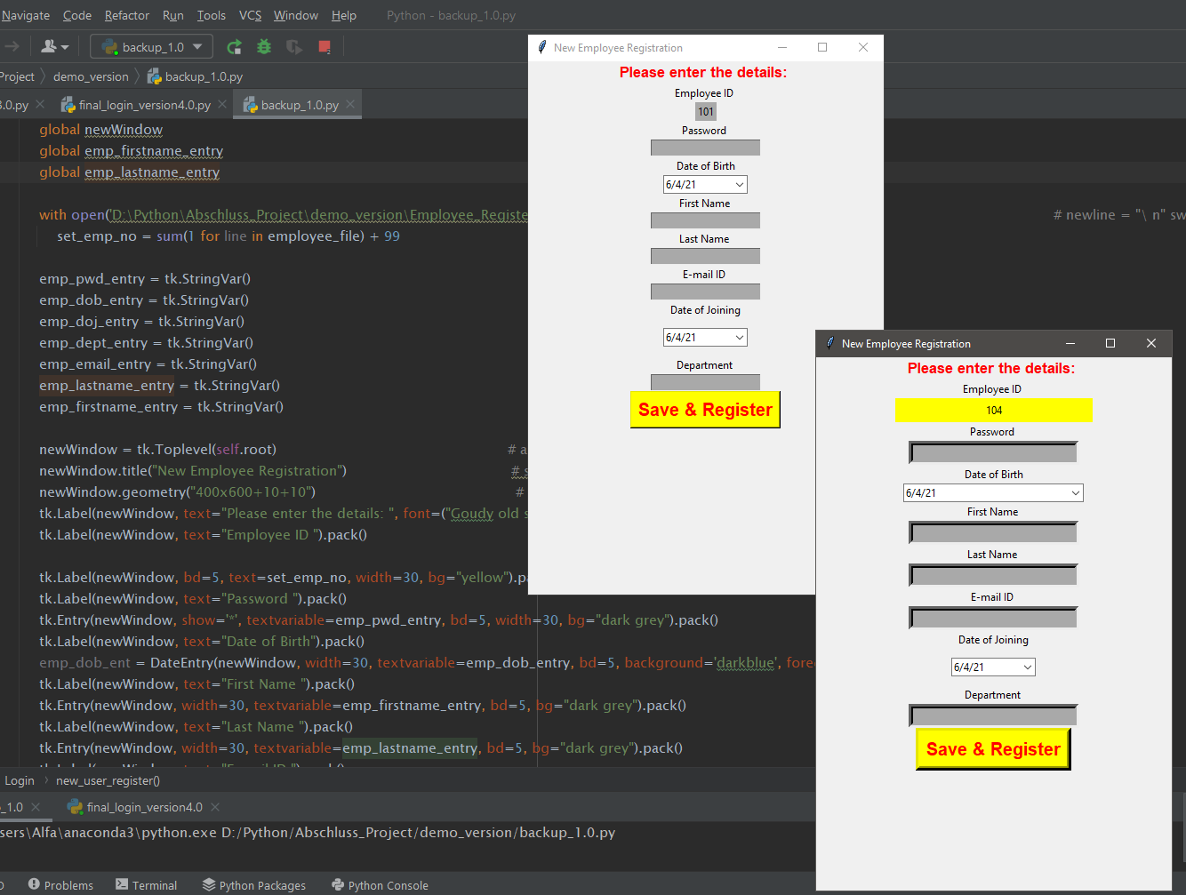
Challenges and Errors
The Employee Id is a unique Key and must be incremented each time. The first value of my ID is : 100. Inspite of setting the ID global, we always had the problem the value setting to 100 and we resolved this problem with my Team combining Agile Methodolgy and resolved the issue.
Problem
Solution
Result

Slide 5
Setting up my Database (Data Structure)
After receiving multiple data, the challenge is to arrange the data and build a good Data Structure.
Log-out Time
Emp_ID
Log-in Date
Log-in Time
Key
Tuple creates unique Key
Retrieving fist Info from the User during registeration and saving this in to our database on Register. New Registeration > Save+Create Acct.
1
Value
Login Session, extracting basic details like Employee ID, Log-in Date, Log-in Time, Name etc.
2
3
Return to adding Logout Time, and the solution was to choose a unique Key, which is Tuple !
Extra Information: This Key-value data structure offers lot of Flexibility.

Slide 6
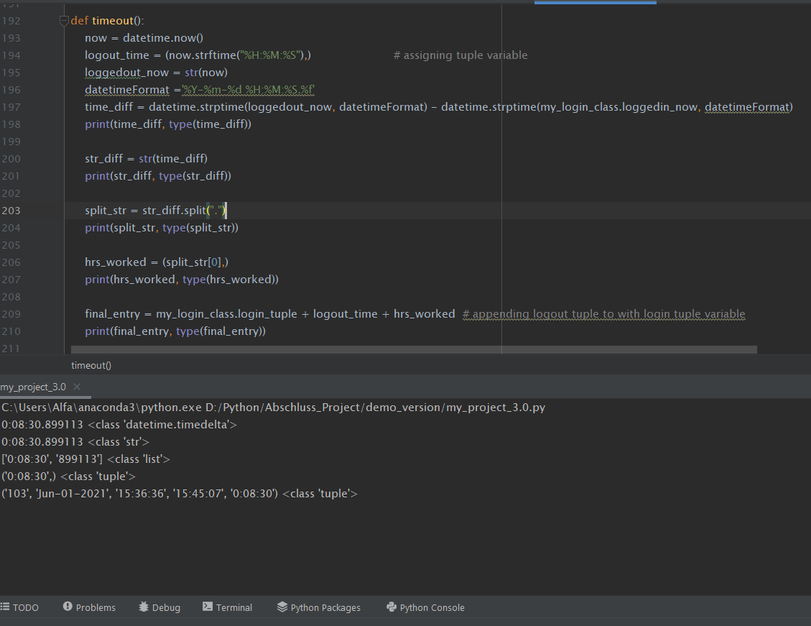
Calculating Log-Out (Time Delta, Overtime, Salary

Slide 7
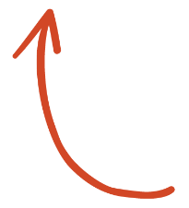
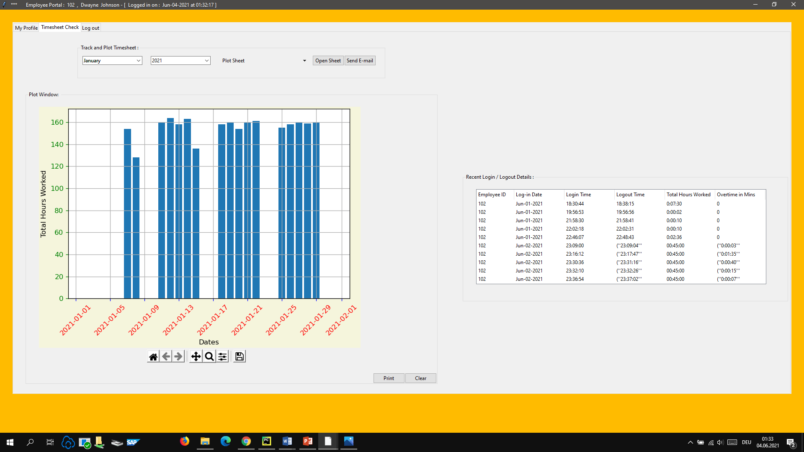
„Access and Plot " Data stored in Systematical Method.
Worked with ttk Tkinter
Implemeted below main Design Frame :
Demo Employee Portal
1
Notebook ttk
2
Treeview ttk
3
Canvas Matplotlib.pyplot

Slide 8
PyTym Advancements
Billing
Easy Billing and Track Budget
Performance
Project Performance
Automate process
Automate process
Review
Employee Review
Notes:
Wählen Sie im Präsentationsmodus die Pfeile aus, um Links zu folgen.

Slide 9
Success, without Team ?
Thank you
all my Team Members,
my Colleagues,
Dr.Eng. Feiler
& my Daughters (who sacrificed their Pfingst Vaccation)
Notes:
Wählen Sie im Präsentationsmodus die Pfeile aus, um Links zu folgen.

